Slide 2
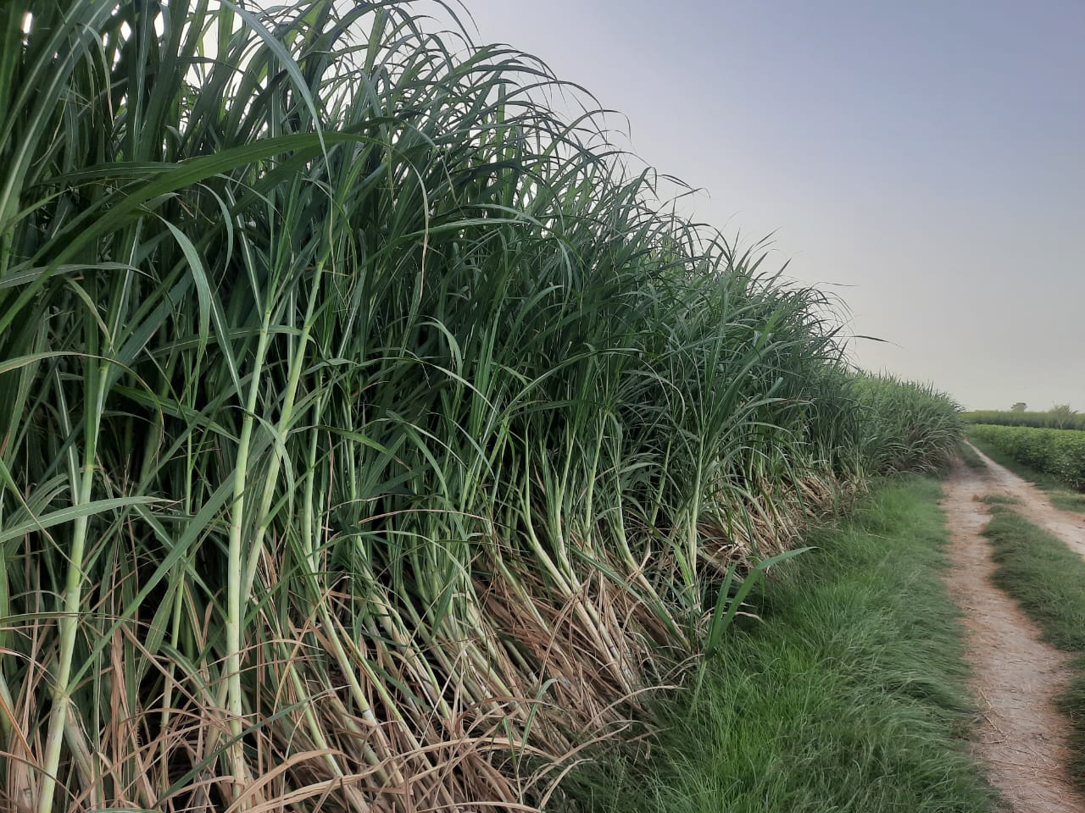
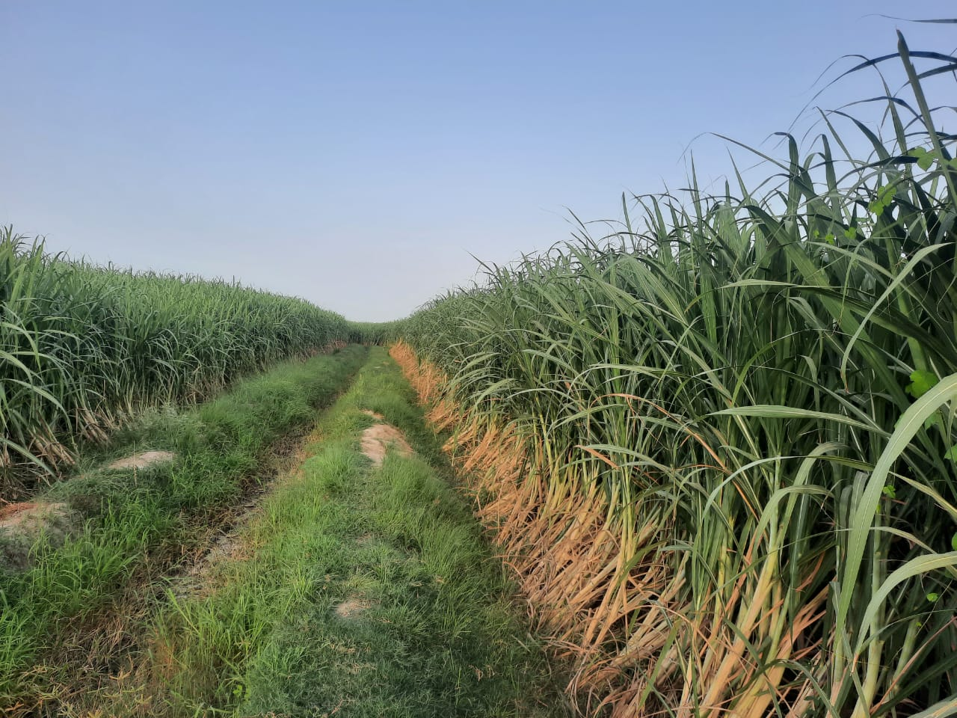
STUDIES ON DISTRIBUTION OF PLANT PARASITIC NEMATODES IN SUGARCANE GROWING AREAS OF JHANG
Presented by : | Aamir Shahazad
Designation : | Principal Scientist (Research & Development)
SHEIKHOO SUGAR MILLS LIMITED, KOT ADDU

Slide 3
INTRODUCTION
Year | Sugarcane Area (ha) | Production (tons) | Yield (Tons/ha) | Sugar Recovery (%)
2021-2022 | 1,259,594 | 88,615,674 | 70.35 | 9.87
(PSMA annual report, 2021-22)
Sugarcane is an important cash crop of Pakistan
Unfortunately yield obtained at present, do not fulfill the local crushing requirements, this might be due to several factors, among them plant parasitic nematodes become the serious threats, because of continuous growing of same crop year after year and poor knowledge about this pest
According to Sasser and Freckman (1987), an estimated overall average annual yield loss on the world’s major crop due to damage caused by plant parasitic nematodes is 12.3%

Slide 4
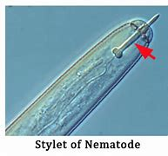
WHAT ARE NEMATODES?
Nematodes are a fascinating, biologically diverse group of organisms.
Over 30,000 species of round worms are found in Nematoda (Hugot, et. al., 2001) typically ranging in size from 0.2 mm to over 6 m.
Nematode body structure is relatively simple and characterized as limbless, cylindrical, and elongated.
Plant parasitic nematodes possess a “hollow stylet” to rupture the wall of roots for entrance

Slide 5
HOW PLANT PARASITIC NEMATODES DAMAGE?
Direct Damage:
Mechanically injuring or destroy plant cells and tissues
Secreting enzymes and toxins
Root system, stunted growth and dieback
Indirect Damage:
Synergism
Creating nutrient rich medium for other pathogens
Act as vectors – for spreading of other fungal and bacterial diseases
Reduced yield

Slide 6
Economic Importance Of Plant Parasitic Nematodes

Slide 7
Summary of Estimated Annual Yield Losses Due To Damage by Plant Parasitic Nematodes Worldwide
Life sustaining crops | Loss (%) | Economically Important Crops | Loss (%)
Sugarcane | 15.30 | Cotton | 10.70
Wheat | 7.00 | Citrus | 14.20
Corn | 10.20 | Eggplant | 16.90
Barley | 6.30 | Tomato | 20.60
Banana | 19.70 | Forages | 8.20
Reference: Information based on worldwide survey of Nematologists (Walia, 2014)

Slide 8
MATERIALS AND METHODS
SOIL SAMPLING
ISOLATION OF NEMATODES (Whitehead and Hemming, 2001)
QUANTITATIVE AND QUALITATIVE ANALYSIS

Slide 9
RESULTS AND DISCUSSION
Quantitative Analysis:
Nematodes Population in 5 ml of suspension:
Samples: | 1 | 2 | 3 | Mean
 | 1,280 | 1,225 | 1,410 | 1,305
5 ml of suspension contains nematodes |  |  | = | 1305
1 ml of suspension contains nematodes |  |  | = | 1305/5
100 ml of suspension contains nematodes |  |  | = | 1305/5*100
No. of Nematodes found in 500 gm of soil |  |  | = | 26,100 Nematodes

Slide 10
RESULTS AND DISCUSSION
Qualitative Analysis:
Total No. of Plant Parasitic Nematodes (PPN) 100 ml of suspension: 481
Pratylenchus spp. |  | 202 | Hoplolaimus | 185
Helicotylenchus spp. |  | 69 | Meloidogyne | 25
481 Nos. of PPN contains Pratylenchus spp. |  |  | = | 202
1 No. of PPN contains Pratylenchus spp. |  |  | = | 202/481
100 Nos. of PPN contains Pratylenchus spp. |  |  | = | 202/481*100
Percentage of Pratylenchus spp. in sample |  |  | = | 41.99%

Slide 11
TYPES OF PLANT PARASITIC NEMATODES

Slide 12
Population Dynamics of Plant Parasitic Nematodes (PPN) Associated with Sugarcane Roots
Location | PPN / 500 gm of Soil
Basti Ghazi Shah | 2933
Ashaba | 2715
Kot Lakhnana | 2503
Chiniot More | 1815
Pakkay wala | 1505
Kot Khaira | 1203

Slide 13
Identification of Plant Parasitic Nematodes (PPN) Associated with Sugarcane
Location | Identification of PPN at Genera Level
 | Praty. (%) | Helico. (%) | Hoplo. (%) | Hemi. (%) | Melido. (%)
Basti Ghazi Shah | +++ (61) | ++ (35) | +++ (42) | ++ (23) | + (10)
Ashaba | + (16) | ++ (22) | +++ (41) | +++ (42) | + (7)
Kot Lakhnana | + (14) | +++ (45) | ++ (25) | + (15) | (0)
Chiniot More | + (9) | ++ (33) | +++ (41) | 0 | (0)
Pakkay wala | + (13) | ++ (21) | + (5) | 0 | + (3)
Kot Khaira | + (7) | ++ (35) | (0) | + (3) | + (5)
0 = Not received, + = Present in samples, ++ = Common and +++ = Widespread

Slide 14
Data Regarding Cane Yield and Sugar Recovery in Plant and Ratoon crops
Location | Plant Crop |  | 1st Ratoon Crop
 | Cane Yield (Tons/ha) | Sugar Recovery (%) | Cane Yield (Tons/ha) | Sugar Recovery (%)
Basti Ghazi Shah | 87.50 | 9.06 | 64.67 | 9.12
Ashaba | 88.8 | 9.53 | 70.20 | 9.65
Kot Lakhnana | 97.35 | 9.28 | 85.50 | 9.85
Chiniot More | 95.6 | 9.45 | 80.52 | 9.72
Pakkay wala | 120.51 | 9.78 | 102.4 | 10.07
Kot Khaira | 115.62 | 10.05 | 98.70 | 10.18

Slide 15
CONCLUSION
On the basis of soil sample analysis the plant parasitic Nematodes; Pratylenchus, Helicotylenchus, Hoplolaimus, Hemicriconemoid and Meloidogyne were found the most of genera.
Problem was more severe in ratoon crops than plant crop.
The results indicated that higher population of nematodes were found in loose/sandy soils.
Previous studies has shown that nematodes caused a significant reduction in cane yield and sugar recovery.

Slide 16
Thank you!

